Slide 1

Mess Management
Code and Conquer

Slide 2
Survey Overview
Understanding Implications for Project Direction
Objective: Evaluate student perceptions, usability, and motivation for a digital meal attendance tool.
Respondents: 92 responses.
Focus Areas:
• Willingness to mark attendance
• Preference for auto-attendance
• Incentive-driven motivation
• Barriers and ease of use

Slide 3
96% Acceptability Rate
Positive feedback from respondents
97% Interested Users
Willing to use the system
95.8% Perceived Benefits
Recognized advantages of implementation

Slide 4
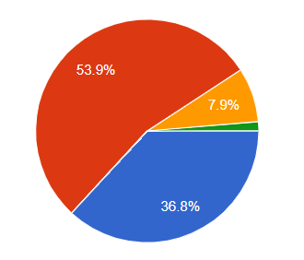
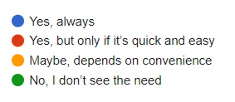
Participation Willingness & Preferences
Willingness to mark attendance:
  “Yes, but only if it’s quick and easy” – 57%
  “Yes, always” – 39%
  “Maybe / No” – 4%
💡 Insight: Most users are open if the process is easy
Preference for auto-attendance:
  “Yes, that’s more convenient” – 75%
  “Maybe” – 25%
  “No” – 6%
💡 Insight: Automation is highly preferred

Slide 5
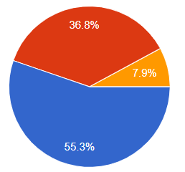

Motivation and Barriers
Motivators:
  “Yes, that would motivate me” – 58%
  “Maybe, nice to have” – 39%
  “No interest” – 8%
Barriers:
  Forgetfulness (most common)
  Internet unavailability
  Process taking too long

Slide 6
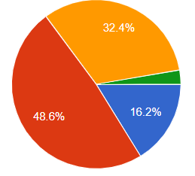
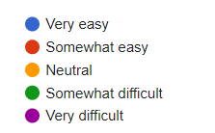
Ease of Use & User Suggestions
Ease of use ratings:
  Somewhat easy – 50%
  Neutral – 33%
  Very easy – 17%
User Suggestions:
  Add motivating factors or rewards
  Ensure fast and reliable system
  Use audio/visual cues for accessibility
  Consider proxy or fairness issues

Slide 7
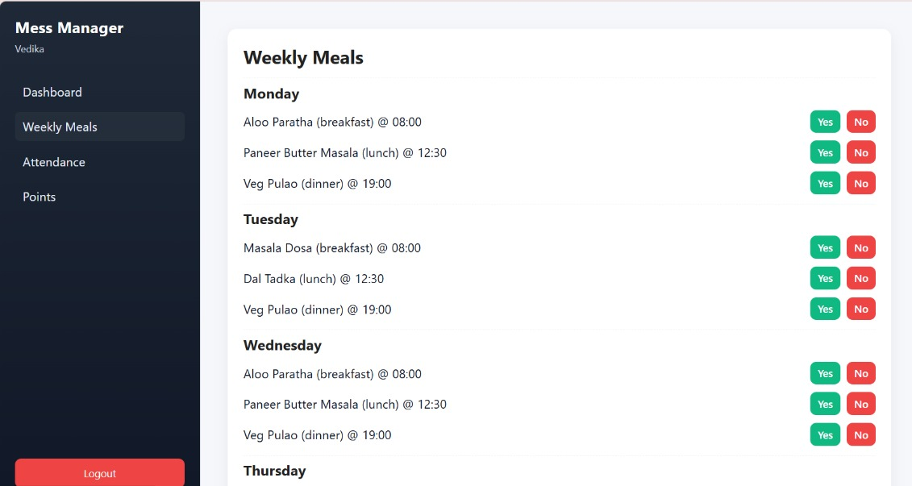
Latest Development Milestones Achieved
Project Status
The project is progressing well with essential features implemented.

Slide 8
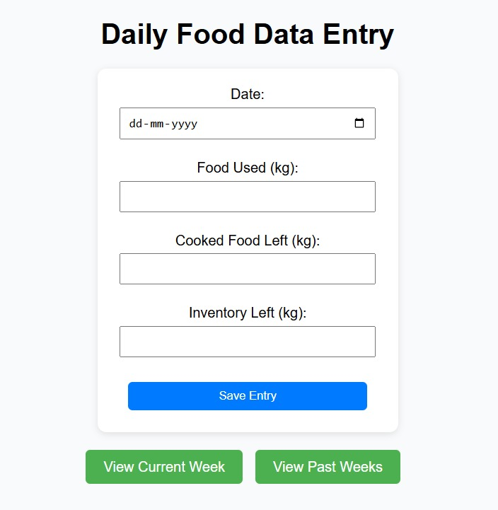
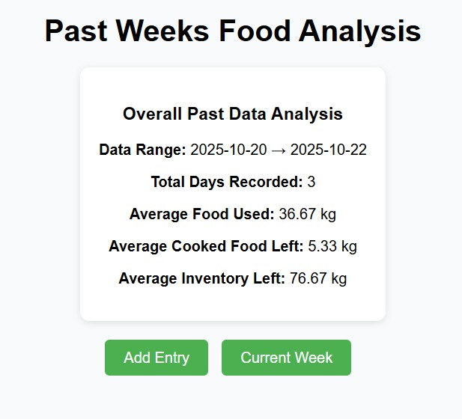
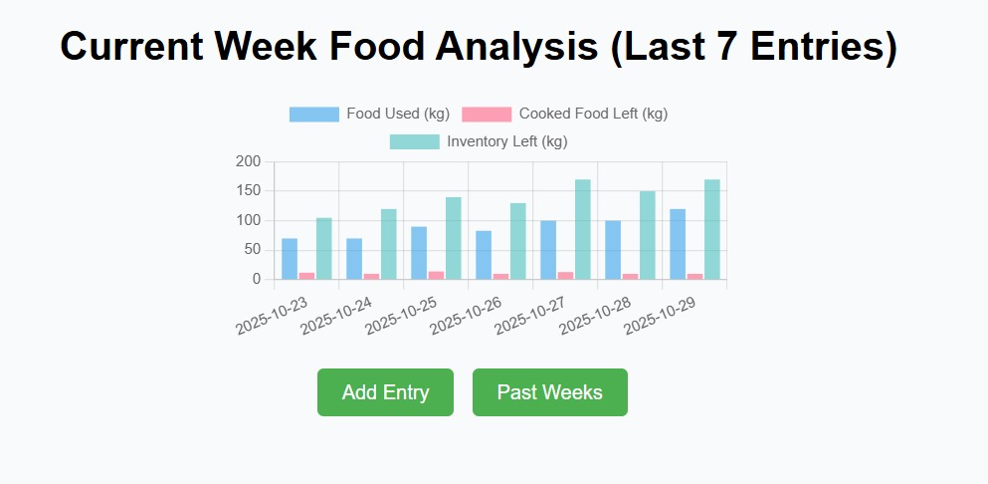
OCTOBER 2025
Staff-Side Food Analysis
Streamlined meal management

